Slide 1

Sentence2SignGesture: a neural machine translation network for sign language video generation
B. Natarajan, R. Elakkiya, Moturi Leela Prasad
Guided by
Neethu M S
Assistant Professor
Department of Computer Science
Presented by
Sharon T K (97422607018)
M.sc AI
Department of Computer Science

Slide 2

Content
Introduction
Motivation
Challenges
Dataset
Methods
Related works
Result Analysis
Conclusion
References

Slide 3
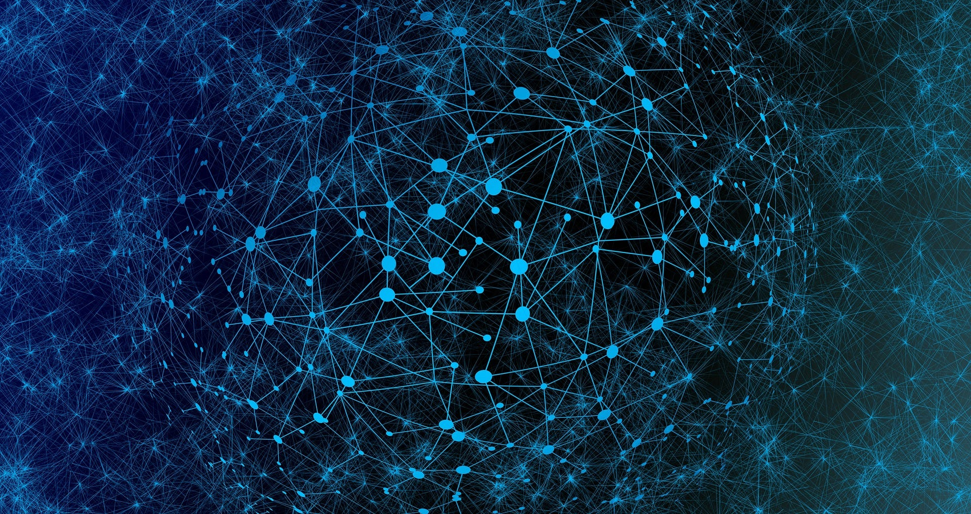

Introduction
Sign language is a manual communication commonly used by people who are deaf
There are 300 different forms of sign language around the world
Different communities may have their own variations of sign language, just as spoken languages have regional dialects.( American Sign Language (ASL), British Sign Language (BSL) and Indian Sign Language(ISL))

Slide 4
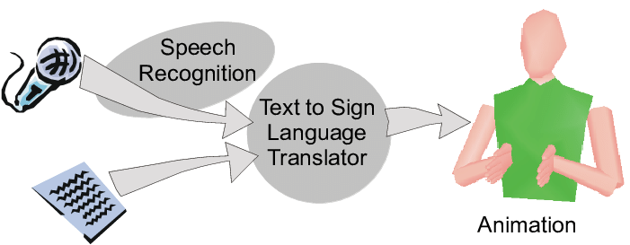





Introduction
The translation of continuous spoken sentences into sign gestures demands higher attention and places huge risks in development
Develop the proposed model for translating the spoken sentences into sign words
The generated sign words (glosses) are mapped with sign gesture videos to automate the sign gesture video generation process using deep generative models
oken
Sentences

Slide 5
Motivation
The primary motivation is to enhance accessibility and inclusivity for the Deaf and hard-of-hearing communities
Fostering better understanding and communication between diverse linguistic communities
Broader trend of leveraging technological innovation for enhancing accessibility
Serve as a valuable educational tool for individuals learning sign language

Slide 6
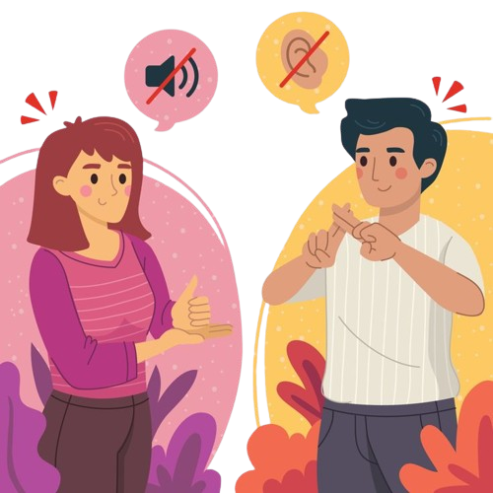
Challenges
Translating the rare words and out-of-vocabularies
Capturing the expressiveness of sign language, including non-manual cues such as facial expressions and body language, presents a challenge
Ambiguities in spoken language may introduce challenges in choosing the correct sign gestures

Slide 7
Dataset
ISL‑CSLTR: continuous sign language translation and recognition dataset
Indian Sign Language dataset
This novel corpus was primarily developed for 100 sentences
The dataset contains 700 sign videos of commonly used spoken English sentences captured at SASTRA Deemed University

Slide 8
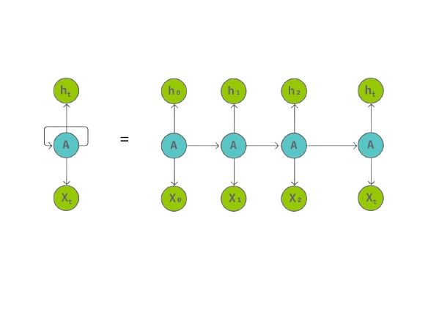
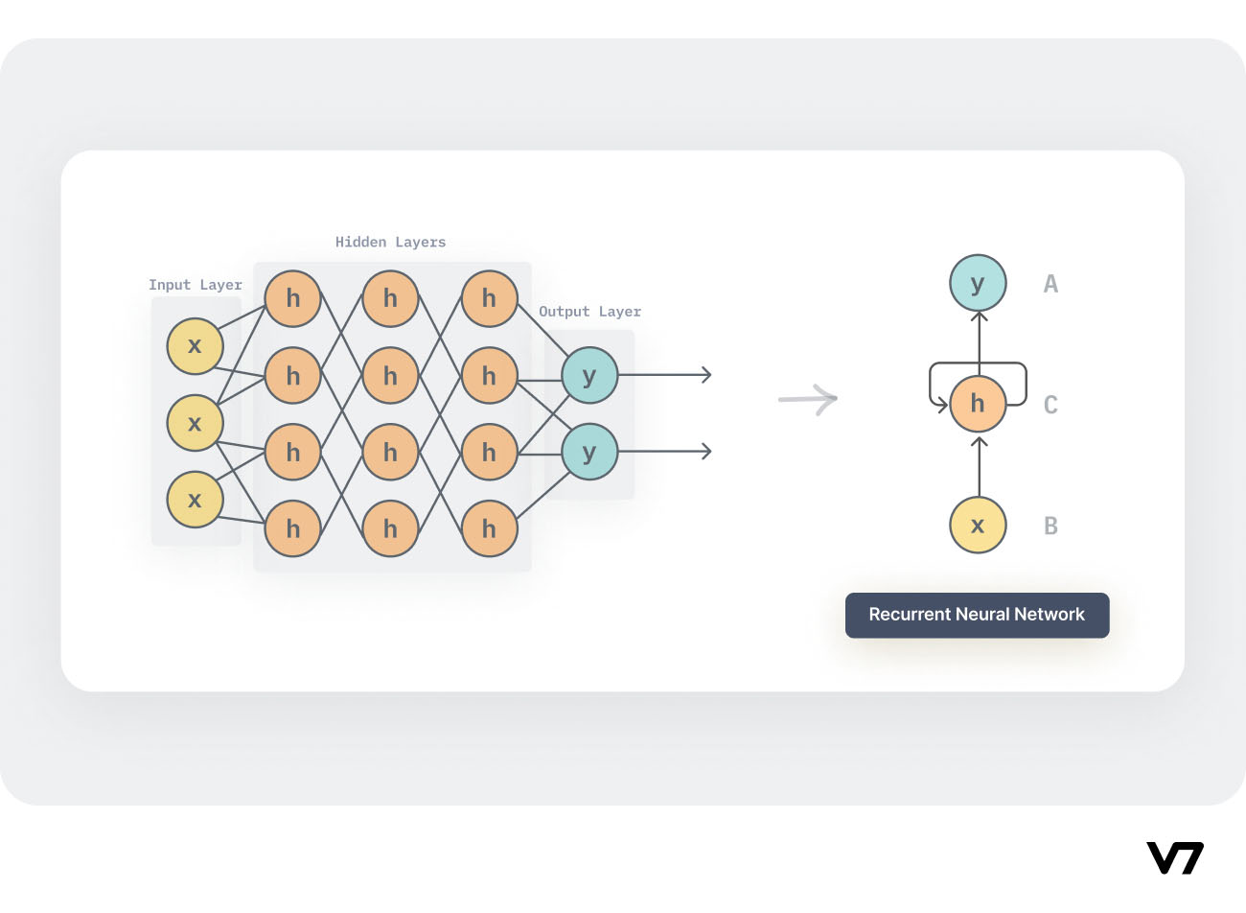
RNN
A recurrent neural network (RNN) is a type of artificial neural network which uses sequential data or time series data.
Ability to maintain a hidden state (memory cell), allowing the network to capture sequential dependencies by remembering previous inputs while processing

Slide 9
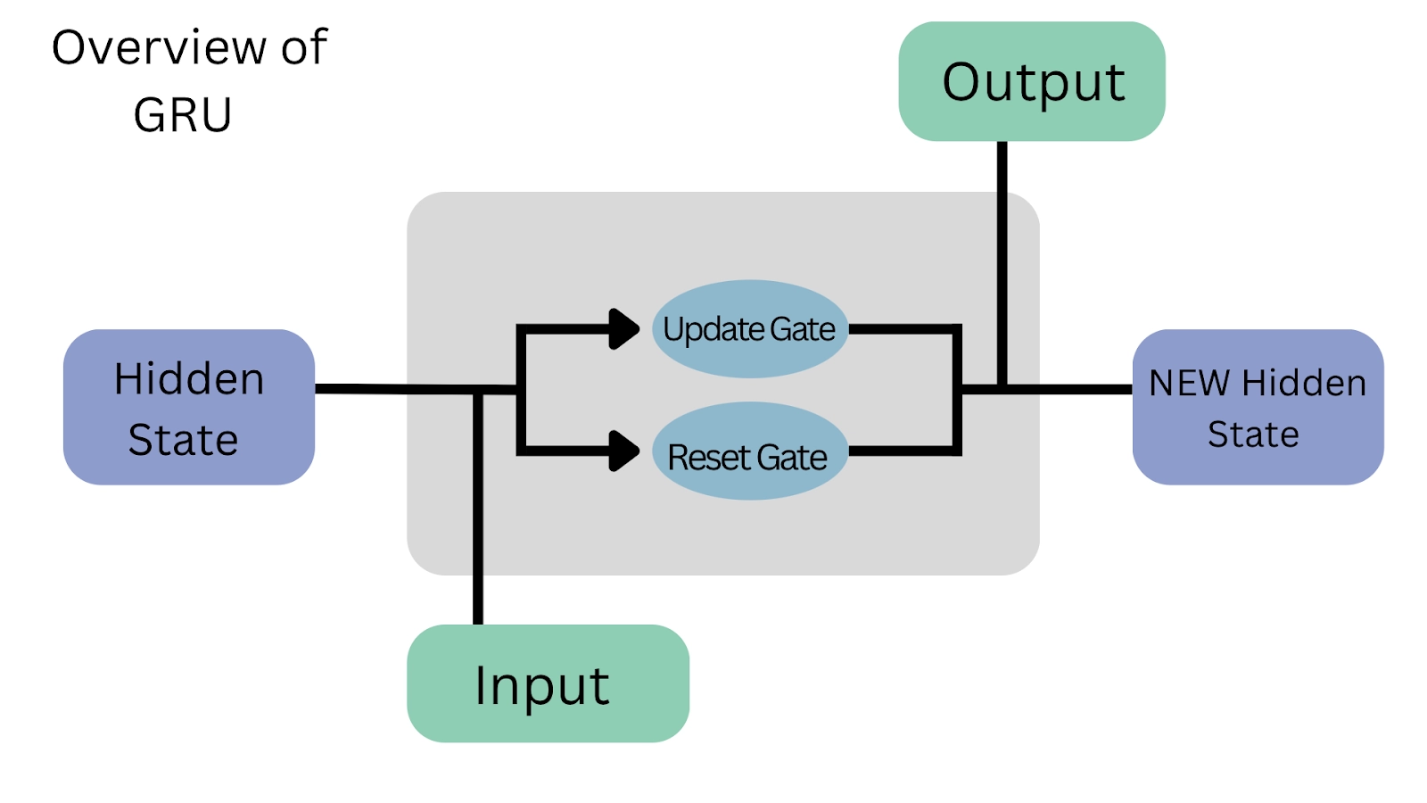
GRU
The GRU is a type of recurrent neural network (RNN) that is well-suited for sequence-based tasks
The GRU introduces gated mechanisms that control the flow of information through the network
Reset gate : How much of the past information should be forgotten or reset
Update gate : How much of the past information should be combined with the current input to update the hidden state

Slide 10
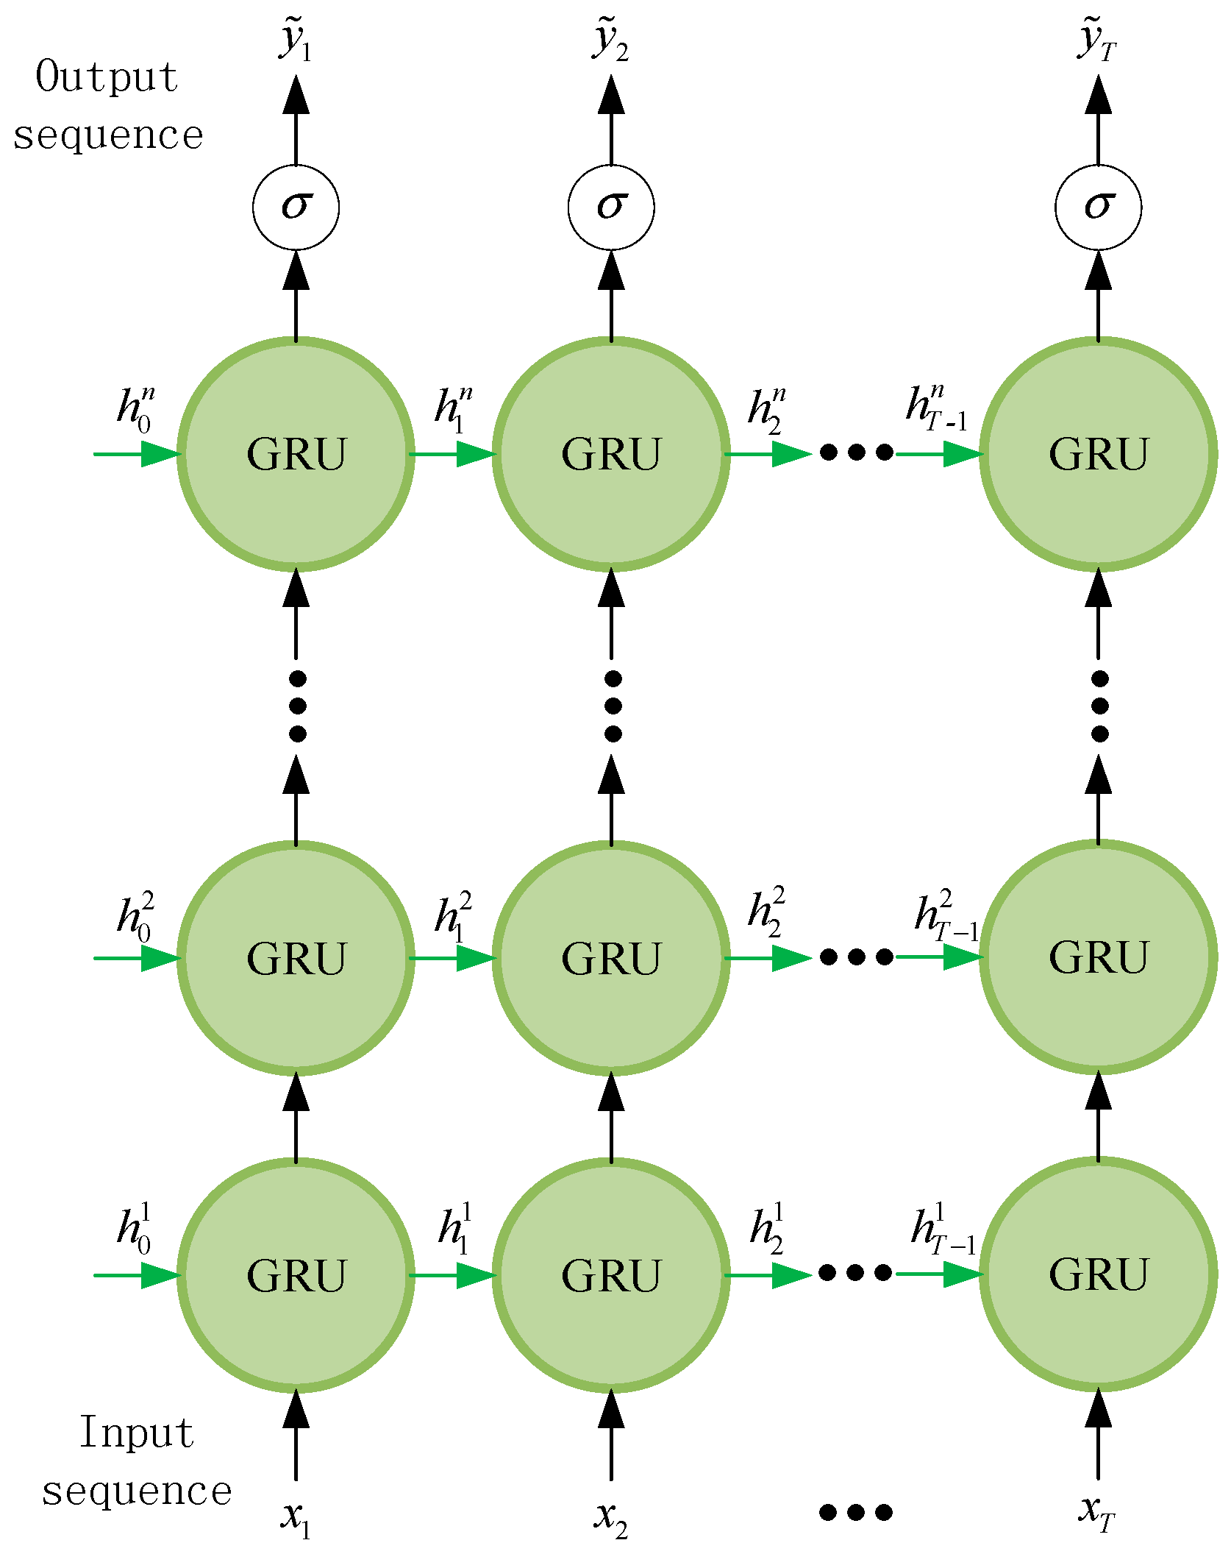
Deep Stacked GRU
Deep Stacked GRU (Gated Recurrent Unit) refers to a neural network architecture where multiple layers of GRU units are stacked on top of each other
Each layer processes the input sequence and passes its hidden state to the layer above it
Allowing the model to capture long-term dependencies
Learn more abstract and complex features.

Slide 11
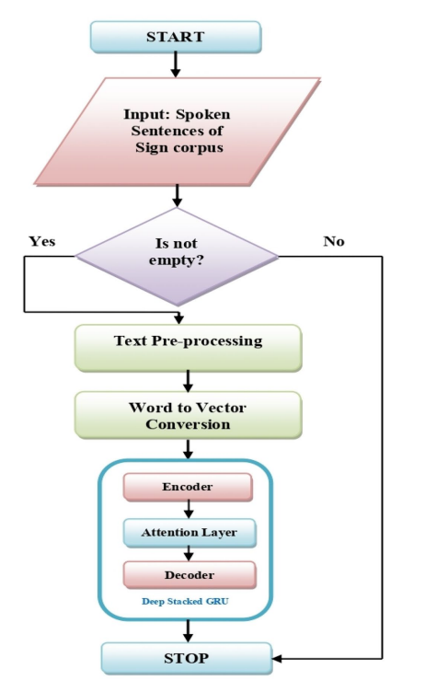
Methods
Proposed Deep Stacked GRU Algorithm based NMT model
The proposed hybrid NMT model consists five parts
Text pre-processing
Encoder Network
Attention Mechanism
Context Vector
Decoder Network

Slide 12
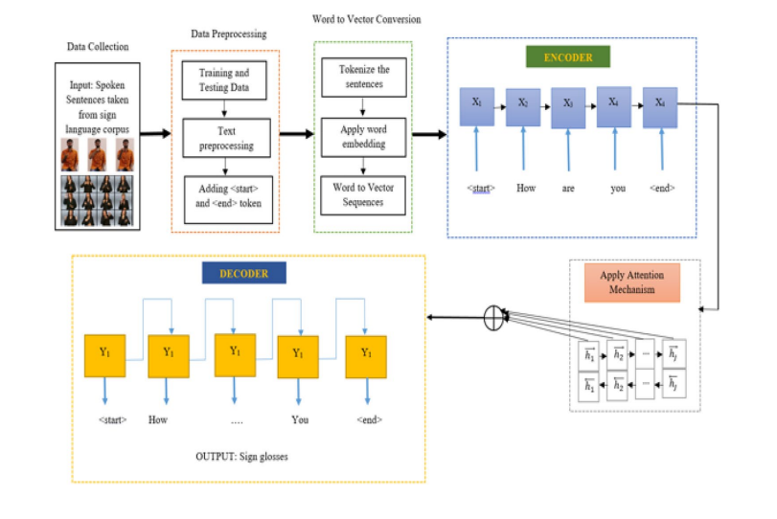
The proposed hybrid NMT system architecture

Slide 13
Methods
Text pre-processing
Remove punctuation marks, symbols and special characters from the sentences
Add <start> and <end> tokens to each sentences
The words are converted into word vectors

Slide 14
Methods
Encoder Network
Encodes a sequence of symbols into a fixed-length vector representation
Reads each word vectors of source sentences with time step t and produces summary at the final hidden layer unit
Each hidden layers keep track of previous hidden layer information associated with vector relationships
The forget gate decides which information to be removed and update gate decides the important key word in a sentence.

Slide 15
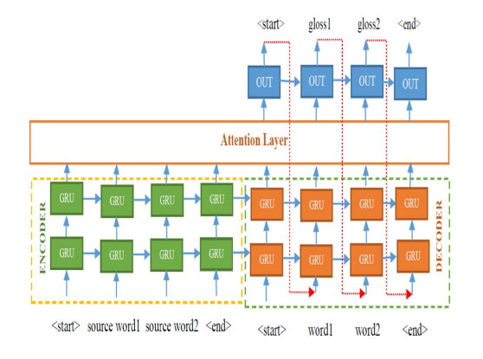
Methods
Attention Mechanism
An attention mechanism is an Encoder-Decoder kind of neural network architecture that allows the model to focus on specific sections of the input while executing a task
Attention mechanism uses softmax function and applies more attention to the important vectors with high probability values and low values to other
Uses Bahdanau’s attention mechanism

Slide 16
Methods
Context Vectors
The context vector captures the semantic information and important features of the input sequence. It serves as a context or memory that the decoder can use to generate the output sequence
Aims to capture both semantic and syntactic information from the input text by leveraging the context from the source and target languages
The context vector values are generated for source sentences by averaging the weight values of source units

Slide 17
Methods
Decoder Network
The first hidden unit of decoder network takes last hidden state summary of encoder unit and context vectors to predict the first word of the target sentence
The decoder processes the target sequence one element at a time. At each step, it takes the previous output (or the actual target in training) and the current state to predict the next element in the sequence
The output layer generates a probability distribution over the target vocabulary, and the element with the highest probability is selected as the predicted output for the current step

Slide 18
Result Analysis
Proposed model achieves better performance than earlier RNN based NMT approaches
The proposed model has been evaluated on sign corpora—ISL-CSLTR Dataset
The proposed NMT model obtained BLEU Scores—39.3 for ISL-CSLTR dataset using single layer GRU

Slide 19
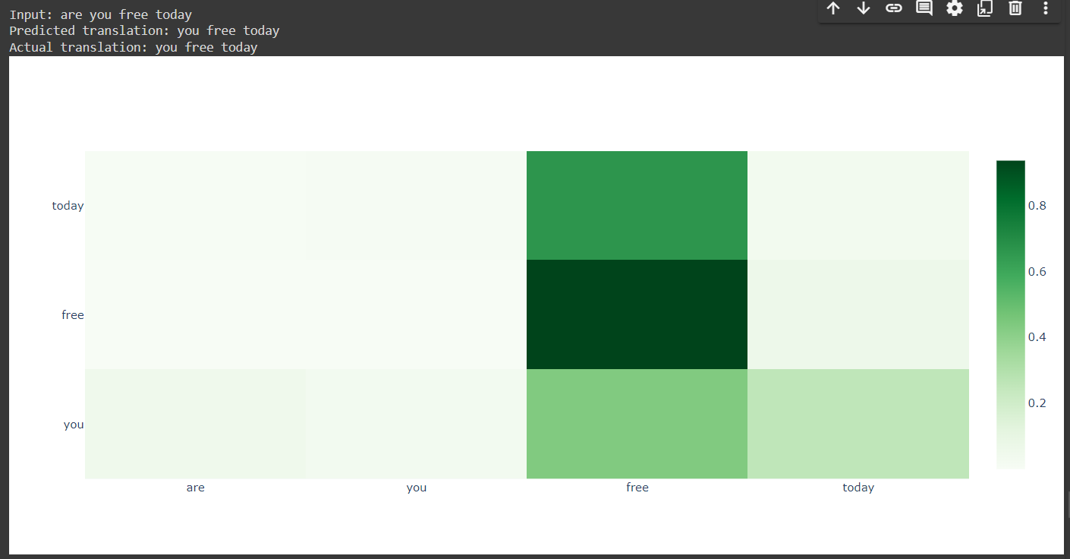
Result Analysis

Slide 20
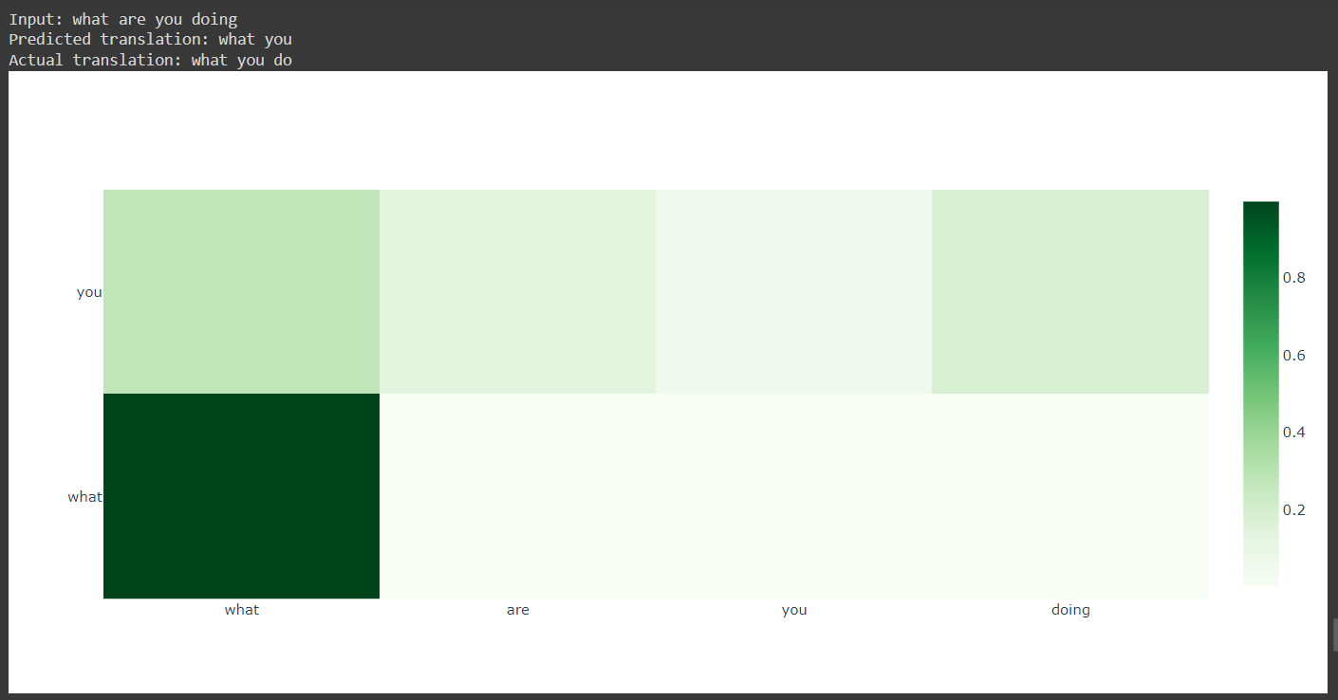
Result Analysis

Slide 21
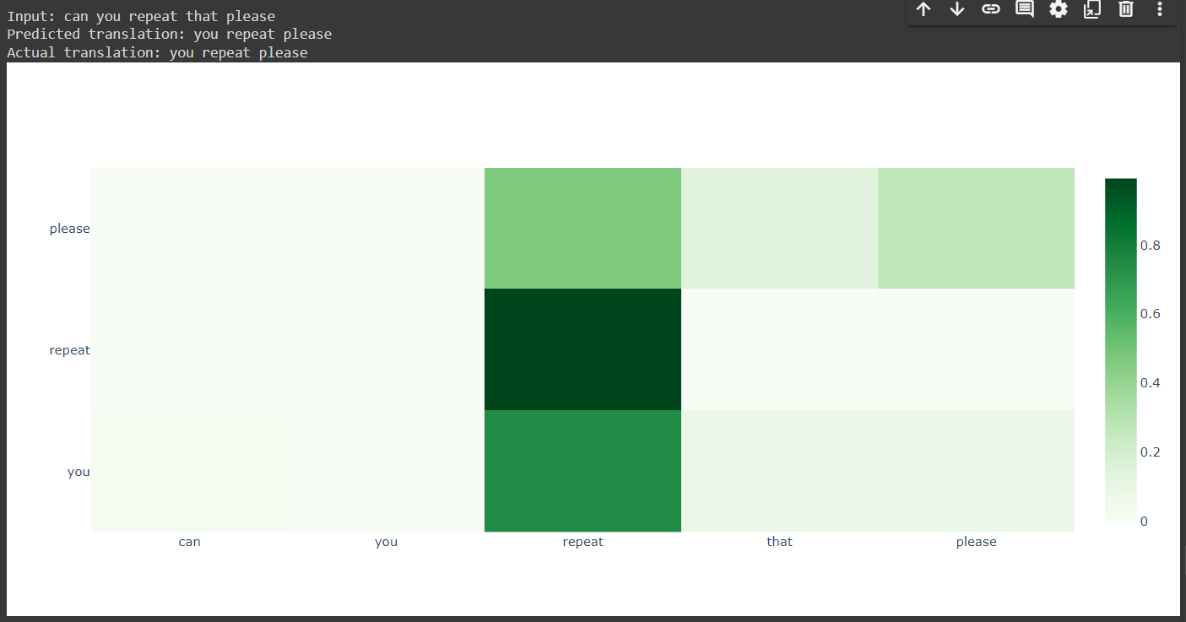
Result Analysis

Slide 22
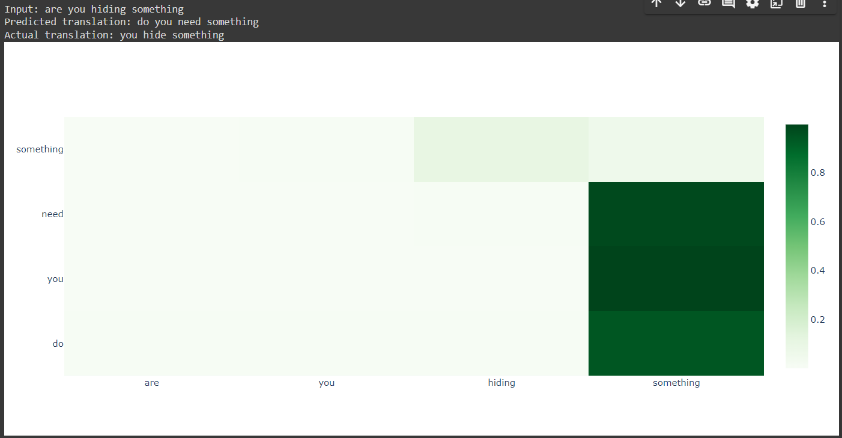
Result Analysis

Slide 23
Conclusion
Proposed model achieves better performance than earlier RNN based NMT approaches
The model became overfitting when using multiple layers of GRU due to small size of dataset
Better performance on single layer GRU due to small dataset
Performance is increased by increasing the dataset size and the GRU layers

Slide 24
Related Works
Paper | Author | Model | Dataset | Remarks
Sequence to Sequence Learning with Neural Networks (2014) | Ilya Sutskever, Oriol Vinyals, Quoc V. Le | LSTM | WMT’14 English to French dataset | BLEU Score : 36.5
Neural Sign Language Translation (2018) | Necati CihanCamgoz, Simon Hadfield, Oscar Koller | CNN+RNN | RWTH PHOENIX-Weather 2014 T | BLEU Score : 19.26
Modeling Coverage for Neural Machine Translation | Zhaopeng Tu, Zhengdong Lu, Yang Liu | Coverage based NMT | NIST | BLEU Score : 30.14
Google’s Neural Machine Translation System: Bridging the Gap between Human and Machine Translation | Yonghui Wu, Mike Schuster, Zhifeng Chen | GNMT | WMT’14 English-French dataset | BLEU Score : 38.95

Slide 25
References
Natarajan, B., Elakkiya, R., & Prasad, M. L. (2023). Sentence2signgesture: a hybrid neural machine translation network for sign language video generation. Journal of Ambient Intelligence and Humanized Computing, 14(8), 9807-9821
Sutskever, I., Vinyals, O., & Le, Q. V. (2014). Sequence to sequence learning with neural networks. Advances in neural information processing systems, 27
Camgoz, N. C., Hadfield, S., Koller, O., Ney, H., & Bowden, R. (2018). Neural sign language translation. In Proceedings of the IEEE conference on computer vision and pattern recognition (pp. 7784-7793)

Slide 26
References
Tu, Z., Lu, Z., Liu, Y., Liu, X., & Li, H. (2016). Modeling coverage for neural machine translation. arXiv preprint arXiv:1601.04811
Wu, Y., Schuster, M., Chen, Z., Le, Q. V., Norouzi, M., Macherey, W., ... & Dean, J. (2016). Google's neural machine translation system: Bridging the gap between human and machine translation. arXiv preprint arXiv:1609.08144

Slide 27
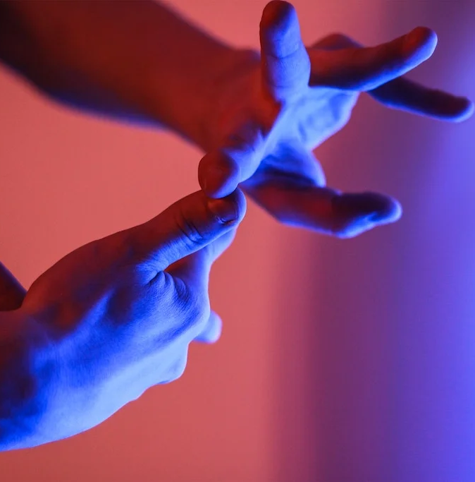
Thank You

